Slide 1
Boundary Conditions: Clockwork
Kavya Sreedhar & Sophia Liu
CS348K
Notes:
Sophia
clockwork compiler

Slide 2
Motivation: Boundary Conditions in Hardware
Boundary conditions for convolutions
Software: if statement
Hardware: more complicated...
We want to design efficient hardware for these edge cases
Notes:
Sophia

Slide 3
Clockwork: Polyhedral Analysis for Hardware Accelerators
Input: Hardware description including memory access pattern
Output: HLS that performs the operation with a usable banked memory implementation
Constraints: Throughput
Notes:
Sophia
Our Goals:
Generate more efficient memory for inputs with boundary conditions
Minimize banking area by adding additional logic to handle edge cases
Setup up the problem: inputs, outputs, constraints goals and assumptions
Clockwork is a tool for compiling naive descriptions of hardware accelerators written as loop nests into high performance, statically scheduled hardware.

Slide 4
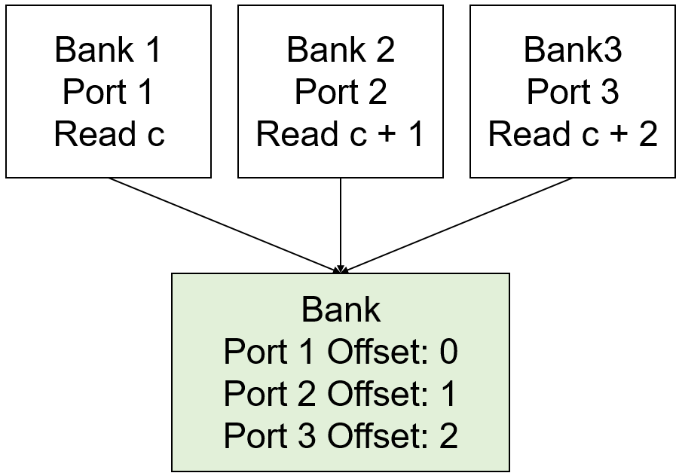
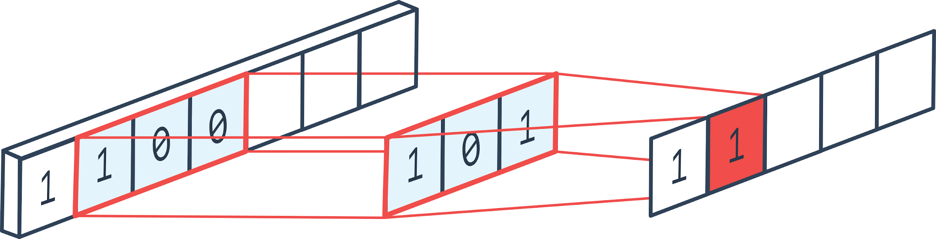
Banking for 1D Conv without Boundary Conditions
Image: 1 by 9 pixels
Properties: 1 by 3 stencil, stride 1
Access pattern:
if (0 <= c <= 7):
out = conv (c, c + 1, c + 2)
Notes:
Kavya
Make a bank for each output port
If output ports have constant read offsets from each other, we can merge the banks and give a bank the right number of output ports from a specific spot
Generating Hardware:
Make a bank for each output port
If bank have constant offsets, merge banks

Slide 5
Input: Greater Flexibility in Specification
Input: Hardware description with piecewise memory access patterns
Old Specification:
individual values: c + 2
min/max: min(c + 2, 9)
New Specification:
{0 <= c <= 7, c + 2}, {c > 7, 9}
Notes:
Sophia

Slide 6
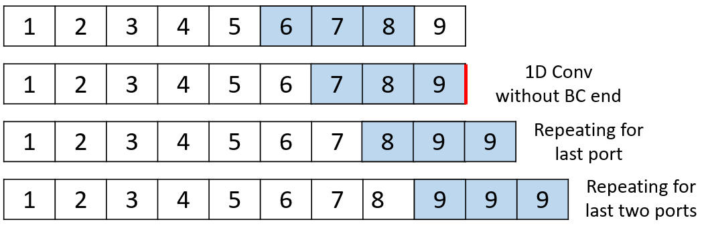
Banking for 1D Conv with Clamping Boundary Conditions
Image: 1 by 9 pixels
Properties: 1 by 3 stencil, stride 1
Access pattern:
if (0 <= c <= 7):
out = conv (c, c + 1, c + 2)
elif (c <= 8):
out = conv (c, c + 1, 9)
elif (c <= 9):
out = conv (c, 9, 9)
Problem:
Read port offsets are not constant
Banks cannot be merged
Generate redundant hardware :’(
Notes:
Sophia
Make a bank for each output port
If output ports have constant read offsets from each other, we can merge the banks and give a bank the right number of output ports from a specific spot
Problem: with boundary conditions, we cannot merge banks because the offset is not constant (e.g. 3rd port)
generated hardware becomes 1 port solely dedicated to that 3rd port and is not merged

Slide 7
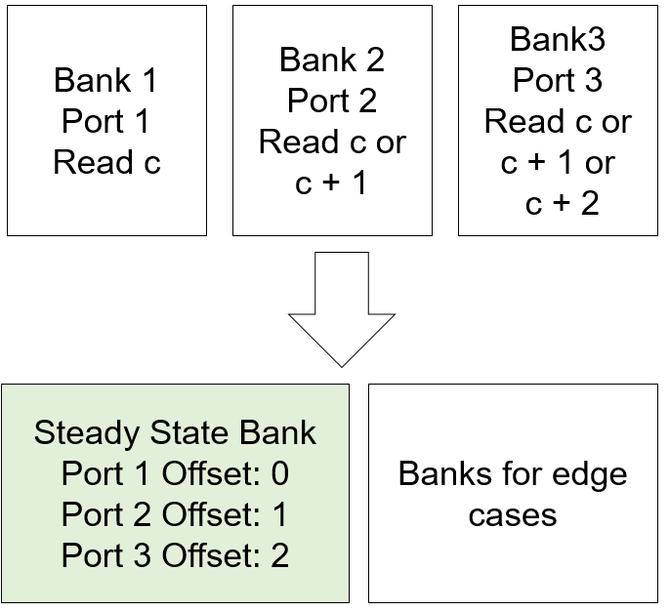
Output: More Area Efficient Hardware for Boundary Conditions
Output: HLS performing the operation with a usable banked memory implementation that is area efficient
Old output:
Merge banks based on constant offset
New output:
Separate non-constant offsets into a steady state and edge case pattern
Merge banks steady state patterns
Notes:
Kavya
Our Goal: Minimize banking area by adding additional logic to handle edge cases
Our Goals:
Generate more efficient memory for inputs with boundary conditions
Minimize banking area by adding additional logic to handle edge cases
Setup up the problem: inputs, outputs, constraints goals and assumptions
Clockwork is a tool for compiling naive descriptions of hardware accelerators written as loop nests into high performance, statically scheduled hardware.

Slide 8
Thank you!

